Slide 1
Data Science Roles and their Salaries around the world
Presented by Carl Gonzales, Prathima Polavarapu, Shang Xu

Slide 2
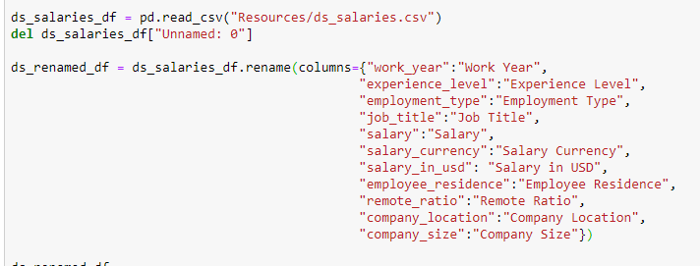
Data exploration and clean up process
Notes:
So to briefly explain the clean up process.
So we started off by obviously reading in the csv file.
For the most part, the data was quite clean already.
There was a blank first column that we wanted to remove so we just used the delete function for that.
And since the csv file had ugly column titles we wanted to rename them so they were legible enough to understand.

Slide 3
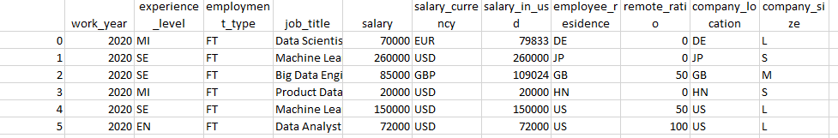
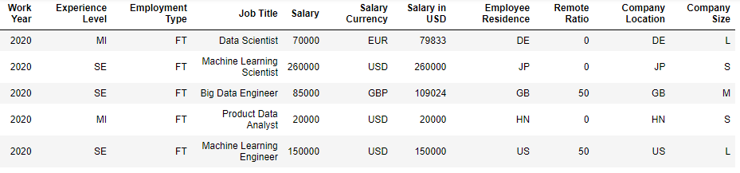
Notes:
So at the top is the original csv file that we want to read into Jupyter and clean up.
And at the bottom is what our dataframe looked like after the clean up.

Slide 4
Research Question 1:
How do data science role salaries vary by employee experience level?

Slide 5
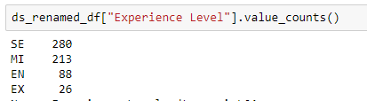
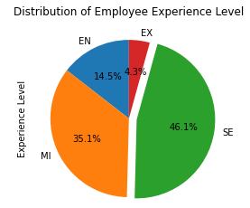
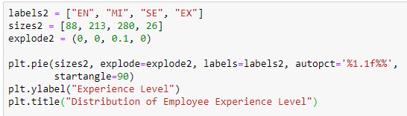
The distribution of employee experience level
Notes:
I wanted to find out the distribution of values of experience level of employees
I ran the value count function to find that shows that employees in the survey predominantly are senior and mid level (which take up around 81% of total sample)
Then I ran the code to create a pie chart to better visualise the data.

Slide 6
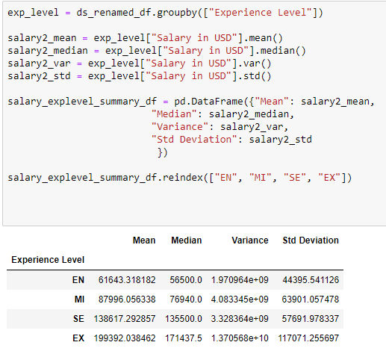
Summary statistics table - experience level vs salary
Notes:
So same thing, I used the groupby function to find the mean, median , variance and std dev for experience level.
It is clear that the average salary increases significantly as an employee progresses from entry level (61,643 USD) all the way to executive level (199,392 USD).

Slide 7
Hypothesis testing – employee salary vs experience level
Null Hypothesis
An employee's experience level has NO EFFECT on their salary.
Alternative Hypothesis
An employee's experience level will result in an improvement on their salary.
Notes:
Furthermore to prove experience level has a positive effect on salary, I did some hypothesis testing for this next question.
Since salary is a numerical variable and experience level is a categorical variable, the most relevant test we can use is ANOVA.
The null hypothesis is 'An employee's experience level has NO EFFECT on their salary.
The alternative hypothesis is 'An employee's experience level will result in an improvement on their salary.

Slide 8

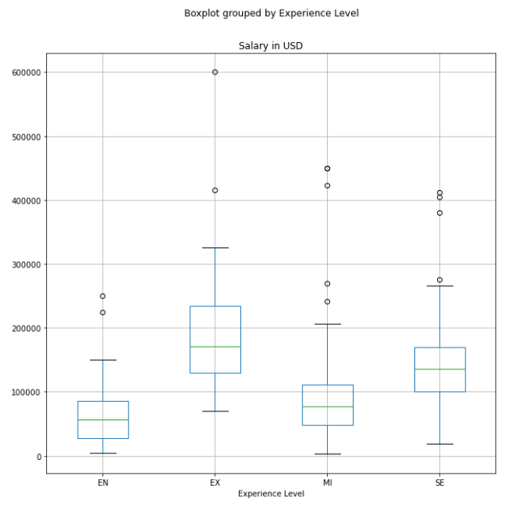
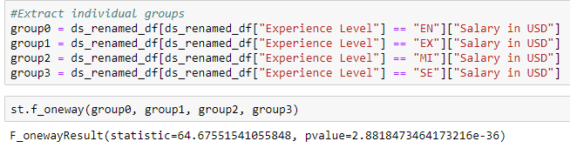
Box plot: employee salary vs experience level
Notes:
I feel like creating the box plot was the most appropriate for this test and when comparing these 2 variables.
As you can see it points out the various salary outliers for each experience level and
Also most importantly we can see the median salary for each shown by the green line. The fact the median lines are not similar, ensures that we can adopt our alternative hypothesis of ‘An employee's experience level will result in an improvement on their salary.’
As for the ANOVA test, I extracted the individual groups to get the f-statistic and p-value calculations.
Since the F-stat value is quite large (64), it is more likely that the variation associated with experience level is real and not due to chance.
Our p-value (2.88x10^-36) is significantly less than 0.05. We can say that we have sufficient evidence that allows us to reject our null hypothesis and conclude that an employee's experience level has an extremely significant effect on their salary.

Slide 9

How do data science Salaries vary by geographic Locations?
prathima

Slide 10
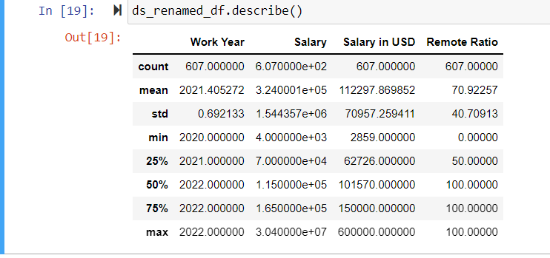
Read & clean data as requirements.
Describe data (Mean , Median and SD data)

Slide 11
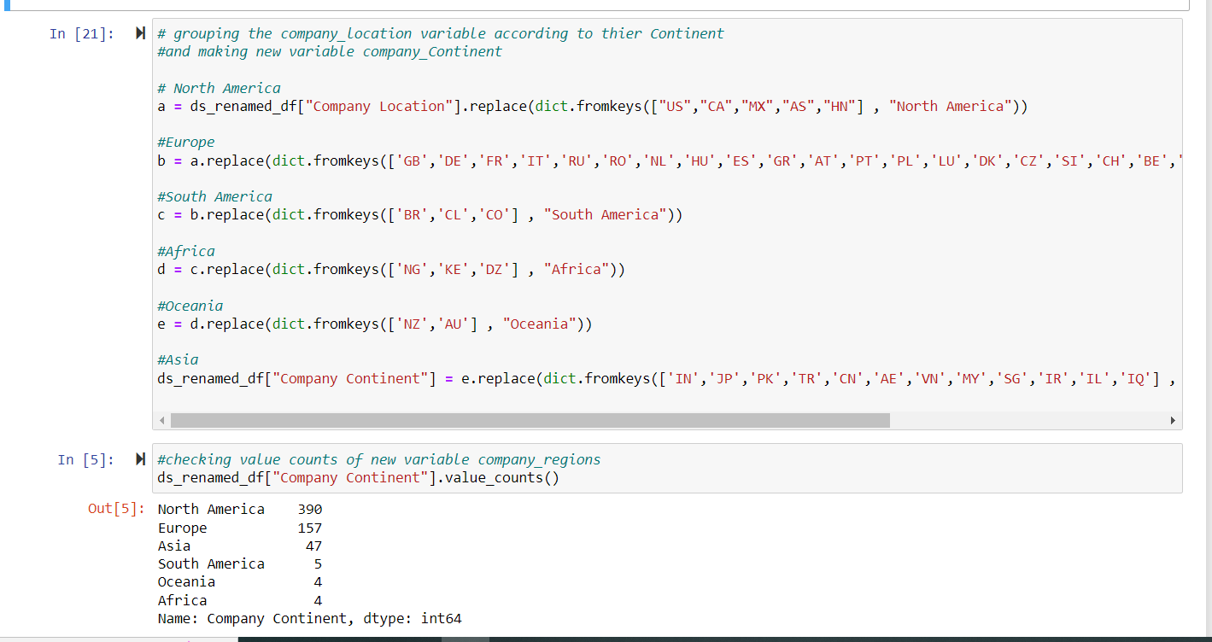
Grouping Company Location, Employee Location to their Continent.

Slide 12
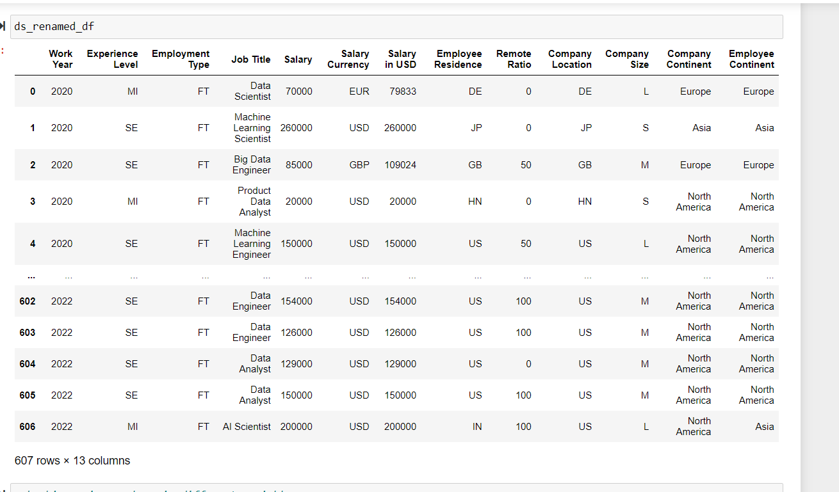
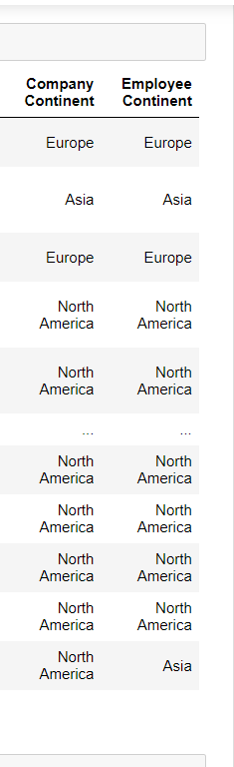
Added 2 Columns into Data Frame

Slide 13
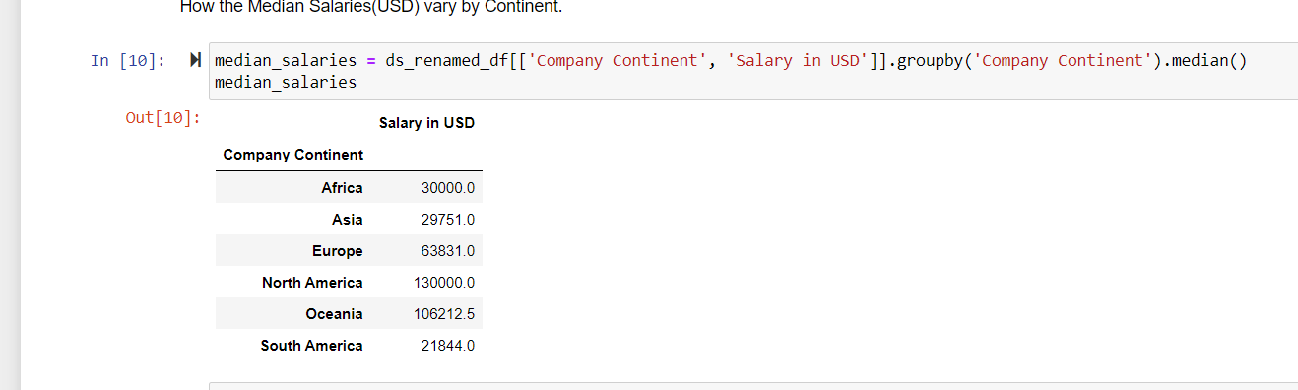
Exploratory Data Analysis 📊

Slide 14
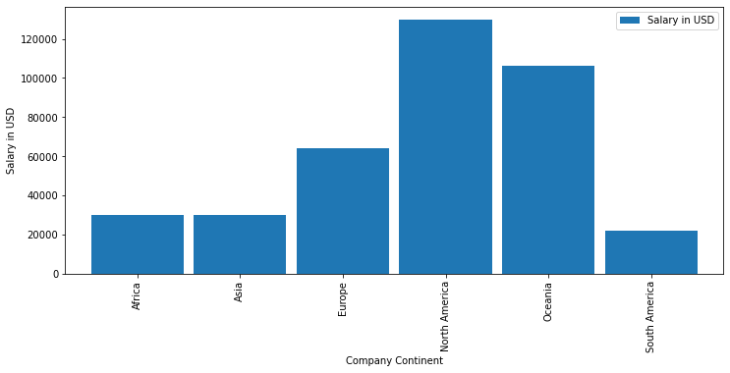
* Observation: In this Graph Shows Highest to lowest Salaries in Continent. North America , Oceania, Europe, Africa, Asia and South America.

Slide 15
API’S and JSON
•I Used Median Salaries(USD) and company continent
.•Created a visualization to represent data on a map by using Jupyter gmaps.
• Marker_layer -- that displays the salaries for every Continent , as in the following image:

Slide 16
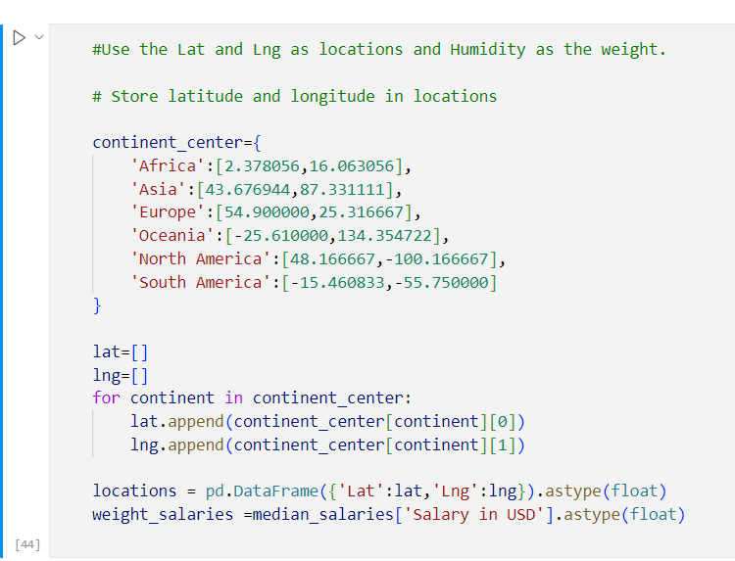
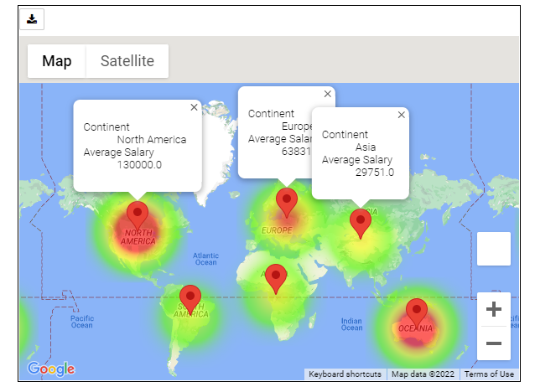

Slide 17
Research Question 3:
How do data science role salaries vary by role type? Out of all the Data Science Job Titles, which Job Title has the highest average salary?

Slide 18
How Many Job Titles In Data Science?
There are 50+ job titles in Data Science.
A lot of job titles are very unpopular.
Which one is the popular job title? Our research will focus on popular job titles.

Slide 19
Which One Is The Popular Job Title?
We will draw a pie chart to present the popular. The pie chart is easy to read and understand.
But there are many job titles, so we classified the unpopular job titles in a new group called ‘Other’.
According to the data, we chose top 14 job titles which has more than 1%.

Slide 20
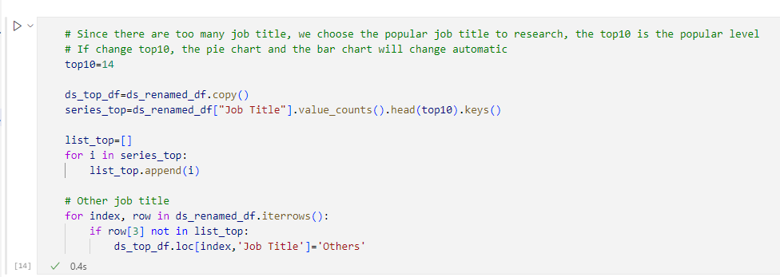
Classify The Unpopular Jobs’ Title As ‘Other’

Slide 21
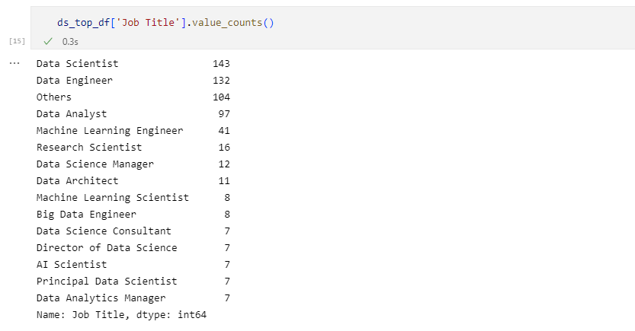
Result

Slide 22
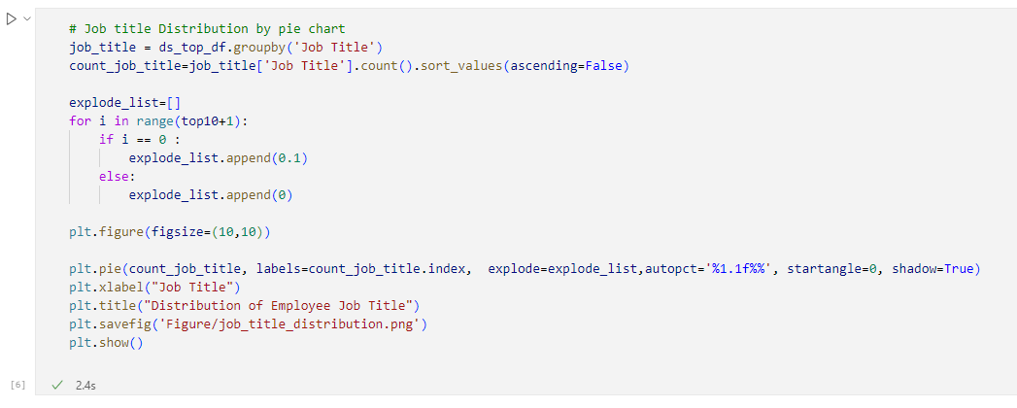
The Popular Job Title, Draw A Pie Chart

Slide 23
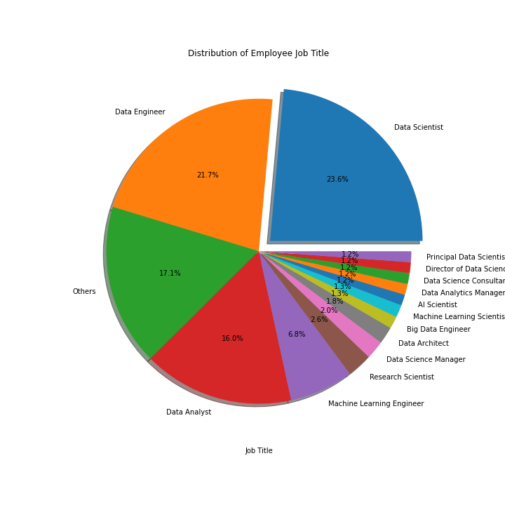
The Pie Chart of Popular Job Title

Slide 24
Major Findings 1
The most popular job title is 'Data Scientist, 23.6%, the second one is 'Data Engineer', 21.7%, the third one is 'Data Analyst', 16%.
The top three accounted for 61.3%.
The other for 17.1%, so the top 14 accounted for 82.9%.

Slide 25
Which Job Title Has The Highest Average Salary?
The high average salary will be research in popular job title. The rare one has few samples, make a average mean nothing.

Slide 26
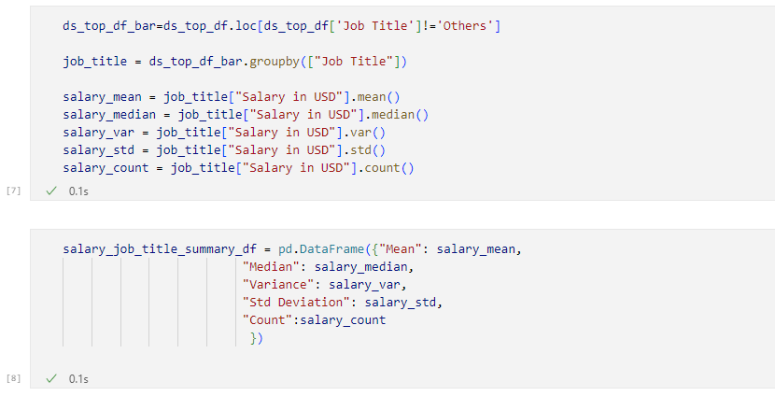
Group By Job Title, And Get Mean/Average

Slide 27
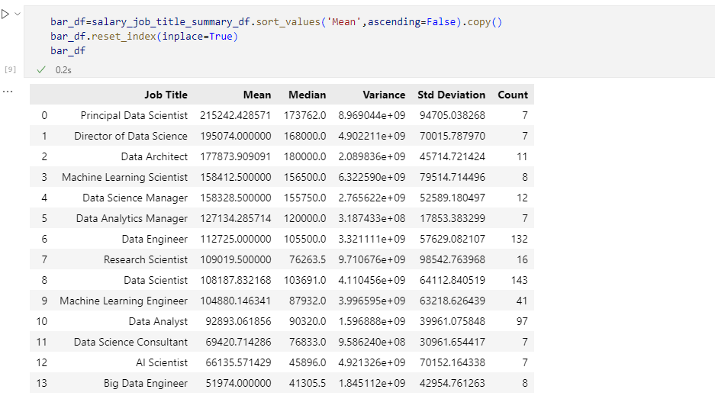
Prepare Data To Draw Bar chart

Slide 28
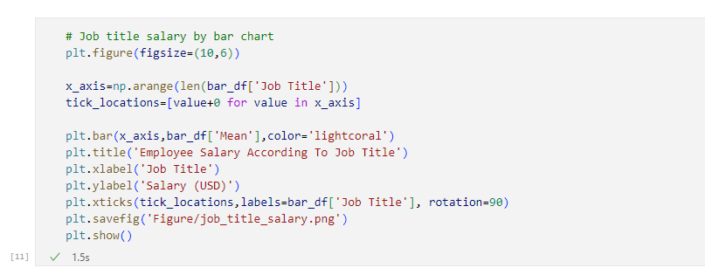
Draw A Bar Chart

Slide 29
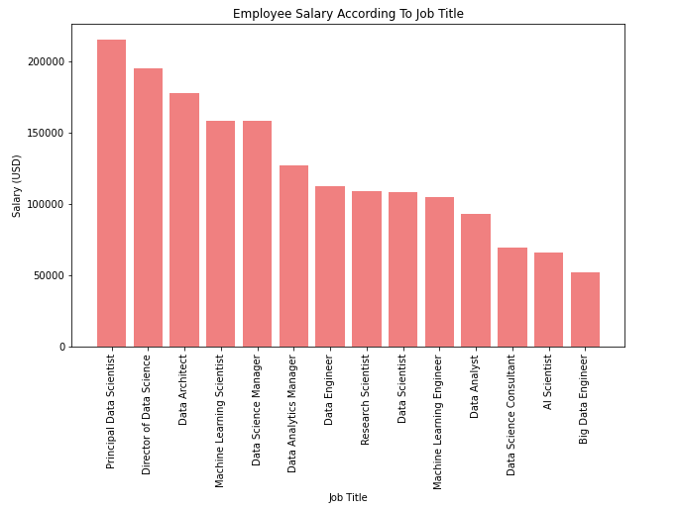
Employee Average Salary According To Job Title

Slide 30
Major Findings 2
The highest salary of job title is 'Principal Data Scientist’, the next one is 'Director of Data Science'.
Except for management position, the highest one is 'Data Architect’.
The 'Big Data Engineer' is not good for employee, this job title average salary is USD 52000, only half of 'Data Engineer'. 'Big' is less.

Slide 31
Resources:
--> Jupytor Python Notebook or Visual Studio Code. (Develop Code)
-->Google API Key (https://console.developers.google.com/getting-started) as 'g_key’
-->Create API Keys and store it in the 'api_keys.py' file before running the Jupyter notebooks.
Search | Kaggle Data Science salaries ( ds_salaries.csv)

Slide 32
The End
Thanks for watching.

